Slide 1
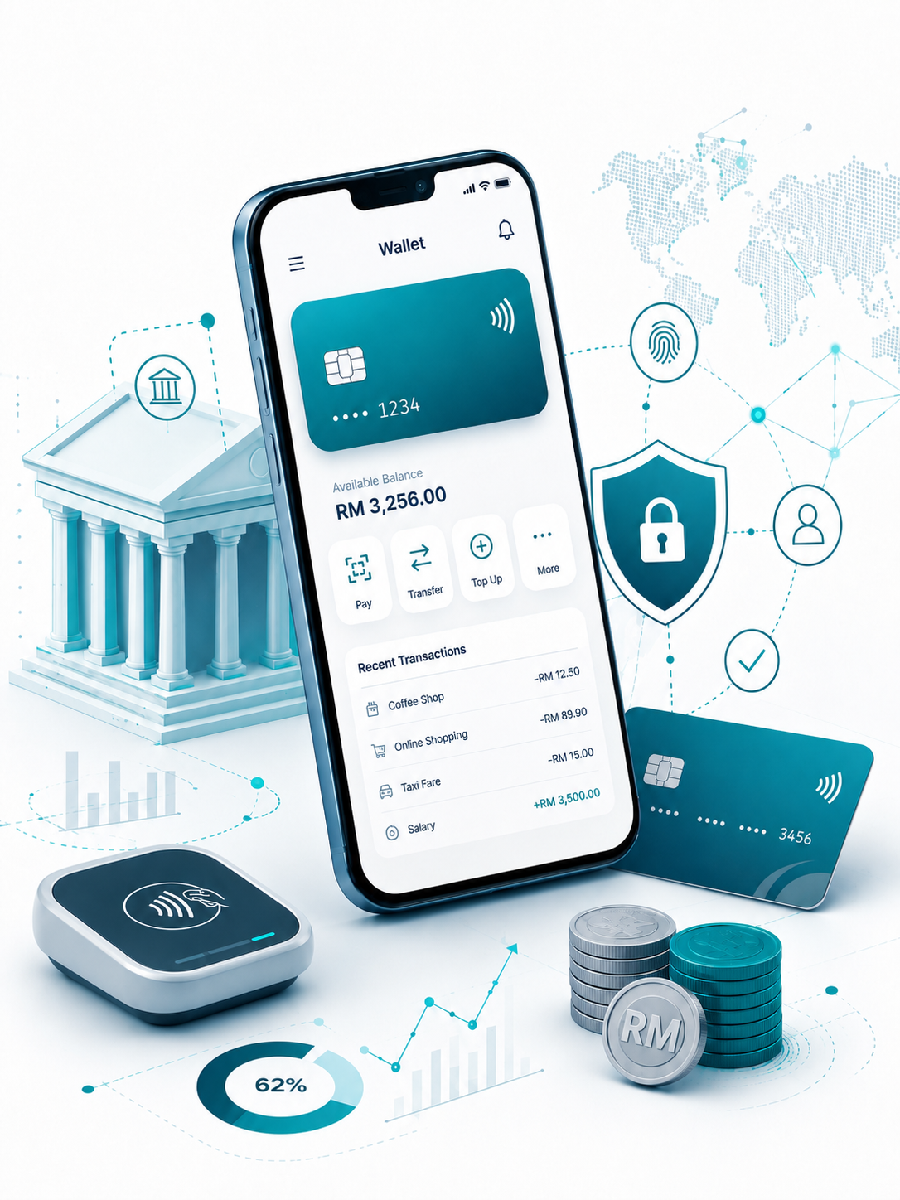

Insert relevant picture related to the topic
TFB3323 FINTECH INNOVATION
WEEK IV
MOBILE AND INTERNET BANKING
Shuhaida Bt M Shuhidan
(Dr (FSMC/UTP))
BACHELOR OF XXXXXX
DEPARTMENT OF COMPUTING
FACULTY OF SCIENCE, MANAGEMENT & COMPUTING
© 2026 INSTITUTE OF TECHNOLOGY PETRONAS SDN BHD
All rights reserved. No part of this document may be reproduced, stored in a retrieval system or transmitted in any form or by any means (electronic, mechanical, photocopying, recording or otherwise) without the permission of the copyright owner.

Slide 2
RECAP FROM PREVIOUS LECTURE
Cutting Out the Middleman: Peer-to-peer (P2P) lending and crowdfunding let savers give money directly to borrowers over the internet, completely bypassing traditional banks.
Four Main Ways to Fund: People can give money for free (donation) , give money to get a gift (reward) , lend money to earn interest (P2P) , or buy a small piece of a startup company (equity).
Cheaper and More Profitable: Because these platforms are online and do not have to pay for physical bank branches, their running costs are very low. This creates cheaper loans for borrowers and bigger payouts for the people lending the money.
Faster Choices with New Data: Instead of just looking at standard credit scores, these platforms use new information (like social data) and smart computer rules to approve loans very quickly.
Helping the Underdog: Banks often reject small businesses or people they think are too risky. Alternative lending makes it much easier and faster for these ignored groups to finally get the cash they need.
Notes:
Learning Outcomes Slide
Note:
Include 2–4 lecture-level learning outcomes
Use measurable action verbs
Map explicitly to Course Learning Outcomes (CLOs)

Slide 3
LEARNING OUTCOMES
By the end of this session, students will be able to:
Define FinTech and contrast it with traditional banking.
Identify the primary technological and cultural drivers of FinTech.
Explain how "unbundling" and "disintermediation" disrupt traditional finance.
Analyze the key challenges faced by both incumbent banks and FinTech startups.
Recognize major global markets and top Southeast Asian FinTech unicorns.
Notes:
Learning Outcomes Slide
Note:
Include 2–4 lecture-level learning outcomes
Use measurable action verbs
Map explicitly to Course Learning Outcomes (CLOs)

Slide 4
TOPICS
Mobile Banking - Introduction?
1.1. Mobile Users vs. Mobile Connections
2. Usability Principles?
2.1. Intuitive and User-Friendly Interfaces?
2.2. Richness of Functionality
2.3. Branding
2.4. Alerts
2.5. Personalization
2.6. UX and CX
2.7. Security and Privacy
Common Mobile Banking Activities
Mobile Only Banks
Digital Agility
Benefits & Advantages
6.1. Cost
6.2. Convenience
6.3. Customer Retention / Loyalty
6.4. More Profitable
Challenges
7.1. Security
7.2. Integration
Assessment of FinTech (Digital Banking)
8.1. Global FinTech VC Investment – Top 15 Global Deals
8.2. Major Forces Impacting Digital Banking
8.3. Where Disruption Occurred
8.4. Disruption of Traditional Banking Models
8.5. Incumbents Moving Systems to Cloud
8.6. Strategies by Incumbent Banks
Notes:
Engagement and Activity Slides
Note:
Include at least one engagement element where appropriate:
Think–Pair–Share
Mini task
Poll or reflection question
Suggested duration: 3–5 minutes
Activities shall align with learning outcomes

Slide 5
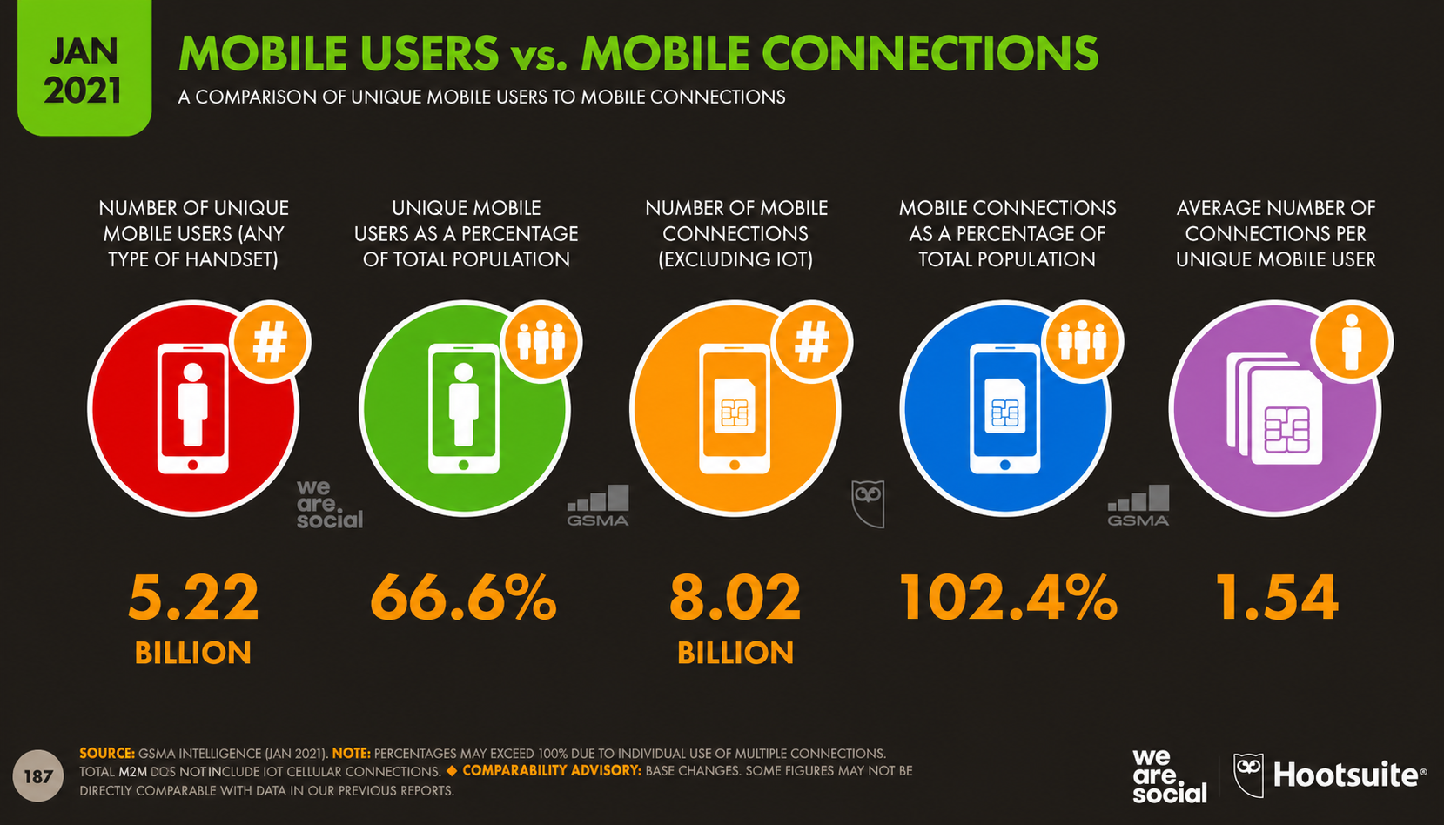
Mobile Banking - Introduction
Notes:
Engagement and Activity Slides
Note:
Include at least one engagement element where appropriate:
Think–Pair–Share
Mini task
Poll or reflection question
Suggested duration: 3–5 minutes
Activities shall align with learning outcomes

Slide 6
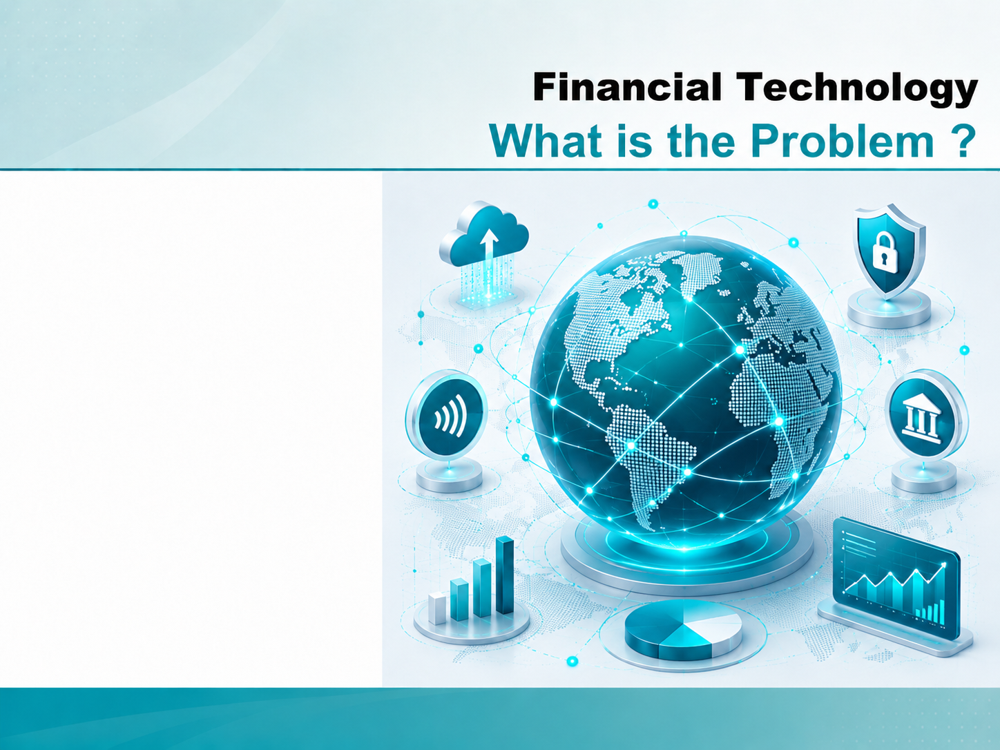
MOBILE BANKING
Usability Principles

Slide 7
Mobile and Internet Banking – Usability:
1.1. Usability Principles
In order to increase the value for the customer of the mobile banking experience, designers must meet the following usability principles:
A mobile banking solution must have an intuitive and user-friendly interface. Users must be able to quickly access desired information or do the correct transaction without navigating through multiple screens or be forced to push too many keys.
There should be cross-fertilization between the teams working for the retail side and for the commercial side of mobile banking. Many lessons learned from consumer use can also be transferred to the commercial solutions for mobile banking.
Notes:
Engagement and Activity Slides
Note:
Include at least one engagement element where appropriate:
Think–Pair–Share
Mini task
Poll or reflection question
Suggested duration: 3–5 minutes
Activities shall align with learning outcomes

Slide 8
Mobile and Internet Banking – Usability:
1.1. Usability Principles - Richness of Functionality
Integration, security, and usability are by far the most important challenges in launching mobile banking. It is important to provide as much functionality as possible. The mobile banking user might need much functionality.
Designers might want to keep the customers away from the bank branches as much as possible. More functionality should not hamper simplicity. This is the challenge.
Financial institutions want mobile banking to be able to sell more services and gain more customers rather than just cannibalizing existing customers. The richer and more convenient the set of functionality on the mobile, the more the financial institutions will be able to meet this challenge.
Notes:
Engagement and Activity Slides
Note:
Include at least one engagement element where appropriate:
Think–Pair–Share
Mini task
Poll or reflection question
Suggested duration: 3–5 minutes
Activities shall align with learning outcomes

Slide 9
Mobile and Internet Banking – Usability:
1.1. Usability Principles - Branding
The mobile banking application will be the “image” of the financial institution to the customers.
It must be appealing and effective. Strictly connected with branding, there is the need to adopt the right style of communication with the customer and use the connection with him/her through the mobile device to offer more and more services.
The financial institution must have a channel policy that assures consistency, cross-fertilization, image reinforcement, integration, and so on across all channels, be they physical (branches , ATM, POS), or virtual.
Notes:
Engagement and Activity Slides
Note:
Include at least one engagement element where appropriate:
Think–Pair–Share
Mini task
Poll or reflection question
Suggested duration: 3–5 minutes
Activities shall align with learning outcomes

Slide 10
Mobile and Internet Banking – Usability:
1.1. Usability Principles - Alerts
Alerts, especially for pending transactions, are critical for all banking transactions. Customers are used to this in the PC online channel. They expect alerts to carry through to mobile. This is even more important because the mobile is always on and with the customer.
Customers of financial institutions should be able to receive notifications with regard to movement on their accounts. They should be able to keep track of their accounts at anytime with information sent straight to their phones. This basic account functionality should provide customers with alerting capability available to all types of mobile banking. This service should generate push and pull alerts depending on customer preferences/settings.
Notes:
Engagement and Activity Slides
Note:
Include at least one engagement element where appropriate:
Think–Pair–Share
Mini task
Poll or reflection question
Suggested duration: 3–5 minutes
Activities shall align with learning outcomes

Slide 11
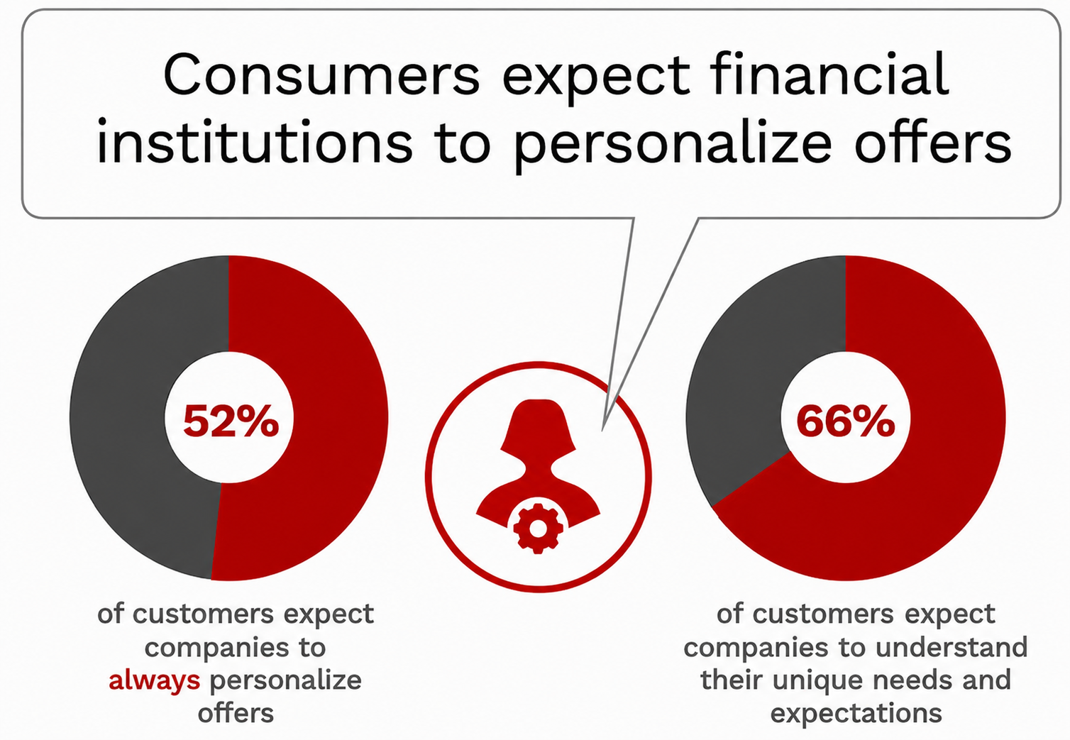
Mobile and Internet Banking – Usability:
1.1. Usability Principles - Personalization
Notes:
Engagement and Activity Slides
Note:
Include at least one engagement element where appropriate:
Think–Pair–Share
Mini task
Poll or reflection question
Suggested duration: 3–5 minutes
Activities shall align with learning outcomes

Slide 12
Mobile and Internet Banking – Usability:
1.1. Usability Principles - Personalization
Personalization will become even more ubiquitous as conversational AI makes many consumer’s basic banking interactions more proactive and human-like. Bank of America has a significant lead in this capability with their AI-powered virtual assistant, Erica, while Wells Fargo just announced the addition of an AI-powered virtual assistant next year (2022). Beyond simple tasks like checking balances, these interactive enhancements can also complete more involved tasks like a financial concierge.
Notes:
Engagement and Activity Slides
Note:
Include at least one engagement element where appropriate:
Think–Pair–Share
Mini task
Poll or reflection question
Suggested duration: 3–5 minutes
Activities shall align with learning outcomes

Slide 13
Mobile and Internet Banking – Usability:
1.1. Usability Principles – UX and CX
The experience should be a peace-of-mind experience, since financial institutions must always reassure customers that their savings or payments are safe. The customer is interested in a secure experience. Security is paramount in his/her relationship with a financial services institution.
A satisfying experience would also mean the possibility of performing more than simple transactions like looking at the balance in a current account. Customers should be able to perform payments, money transfers, selling/buying shares or bonds, and so on.
Notes:
Engagement and Activity Slides
Note:
Include at least one engagement element where appropriate:
Think–Pair–Share
Mini task
Poll or reflection question
Suggested duration: 3–5 minutes
Activities shall align with learning outcomes

Slide 14
Mobile and Internet Banking – Usability:
1.1. Usability Principles – Security and Privacy
Security and privacy are nonnegotiably characteristics in mobile banking.
In developing a mobile banking solution, designers should give priority to security. There must be ways to ensure that the person who is connecting is indeed the customer accessing his/ her account. It is essential also to provide a secure connection, which very likely means encryption in the transmission and storage in the handset.
Notes:
Engagement and Activity Slides
Note:
Include at least one engagement element where appropriate:
Think–Pair–Share
Mini task
Poll or reflection question
Suggested duration: 3–5 minutes
Activities shall align with learning outcomes

Slide 15
Mobile and Internet Banking – Usability:
1.1. Usability Principles – Security and Privacy
Security and privacy are nonnegotiably characteristics in mobile banking.
In developing a mobile banking solution, designers should give priority to security. There must be ways to ensure that the person who is connecting is indeed the customer accessing his/ her account. It is essential also to provide a secure connection, which very likely means encryption in the transmission and storage in the handset.
Notes:
Engagement and Activity Slides
Note:
Include at least one engagement element where appropriate:
Think–Pair–Share
Mini task
Poll or reflection question
Suggested duration: 3–5 minutes
Activities shall align with learning outcomes

Slide 16
Financial Technology – Mobile Banking:
1.1. Common Mobile Banking Activities
Consumers’ most common mobile banking activities :
74 % check balance / statement
63 % mobile cheque deposit
55 % transfer funds between accounts
16 % send money to friends and family
38 % pay a bill
25 % make a payment on credit card or loan
15 % manage investment
32 % locate a branch or ATM
Notes:
Engagement and Activity Slides
Note:
Include at least one engagement element where appropriate:
Think–Pair–Share
Mini task
Poll or reflection question
Suggested duration: 3–5 minutes
Activities shall align with learning outcomes

Slide 17
Common Mobile Banking Activities
Video banking has become increasing popular. Some providers allow customers to talk to experts on their mobile, tablet or PC outside conventional bank branch hours rather than taking time out of their working day.
A certain number of mobile-only banks have been launched recently. Their characteristic is to offer the full set of banking products on the mobile (including smartphones and tablets), and only on the mobile.
The initial launches of many mobile-only banks have been successful: in a short time, there have been a relatively large number of new subscribers.
Mobile-only banks’ concept and ease-of-use resonates well with younger, tech-savvy customers, but any user of the mobile could come to like it. It is very important that the apps, websites, and various features be quite easy to navigate and understand.
Notes:
Engagement and Activity Slides
Note:
Include at least one engagement element where appropriate:
Think–Pair–Share
Mini task
Poll or reflection question
Suggested duration: 3–5 minutes
Activities shall align with learning outcomes

Slide 18
Financial Technology – Mobile and Internet Banking:
1.1. Digital Agility
The Banks need to constantly be up-to-date with new market changes, technologies, and laws, which requires them to be adaptive and agile in order to do so. Agility would allow them to differentiate themselves from their competition in their approach in delivering services that are targeted, personalised, and unique.
A These differentiators would include, a scope focused on creating new value propositions that are integrated in customers’ day-to-day lives, consortiums allowing access and availability to a wider range of products and offerings, and technologies that would enhance the banking experience.
Notes:
Engagement and Activity Slides
Note:
Include at least one engagement element where appropriate:
Think–Pair–Share
Mini task
Poll or reflection question
Suggested duration: 3–5 minutes
Activities shall align with learning outcomes

Slide 19
MOBILE AND INTERNET
BANKING
Benefits
&
Advantages

Slide 20
Financial Technology – Mobile and Internet Banking:
1.1. Advantages - Cost
The main advantage for Financial Institutions is cost.
Mobile banking can help reduce costs. As the number of mobile financial institutions has grown, customers’ visits to the branches have decreased → in the future, they will not be more than 30 percent. Mobile banking accesses have risen by the same amount.
This is bringing substantial cost reductions from USD$4.25 per branch visit to USD$ 0.10 for a mobile access.
Notes:
Engagement and Activity Slides
Note:
Include at least one engagement element where appropriate:
Think–Pair–Share
Mini task
Poll or reflection question
Suggested duration: 3–5 minutes
Activities shall align with learning outcomes

Slide 21
Financial Technology – Mobile and Internet Banking:
1.1. Advantages - Convenience
One of the main benefit to Customers is convenience… the possibility of using the apps everywhere and anytime.
A distinctive feature of mobile banking is the integration of more than one service and function that is available on the mobile, such as geolocalization, picture taking and processing, voice processing, biometrics, optical character recognition (OCR), contactless features, etc.
Notes:
Engagement and Activity Slides
Note:
Include at least one engagement element where appropriate:
Think–Pair–Share
Mini task
Poll or reflection question
Suggested duration: 3–5 minutes
Activities shall align with learning outcomes

Slide 22
Financial Technology – Mobile and Internet Banking:
1.1. Advantages – Customer Retention
Mobile banking customers are less likely to leave. In the Forrester study mentioned above, the attrition rate for all mobile banking customers was 40 percent lower than that of online banking users, and the attrition rate for customers using both mobile banking and bill pay was 53 percent lower than that of online banking users.
A customer survey also reinforced the idea that mobile banking increases customer retention. 30 percent of US mobile banking users say mobile banking has made them more likely to stay with the bank from which they receive the service. This increased customer stickiness results in recurring revenue for financial institutions.
Notes:
Engagement and Activity Slides
Note:
Include at least one engagement element where appropriate:
Think–Pair–Share
Mini task
Poll or reflection question
Suggested duration: 3–5 minutes
Activities shall align with learning outcomes

Slide 23
Financial Technology – Mobile and Internet Banking:
1.1. Advantages – More Profitable
Mobile banking Mobile banking customers are more profitable. SunTrust found that their customers who use mobile banking were 32 percent more profitable. Customers using mobile banking and bill pay were 46 percent more profitable than online banking customers
Mobile banking generates activity. Mobile banking customers used their debit cards more frequently after enrolling in the service. They generated an average of 3.4 more transactions per month, resulting in more revenue for the financial institution
Mobile banking tends to generate more transactions. Its use encourages value-generating activities such as debit card usage. Thanks to the simplified access to banking services, customers increase their average transaction numbers and the average float value. This increases the number of revenue-generating transactions
Notes:
Engagement and Activity Slides
Note:
Include at least one engagement element where appropriate:
Think–Pair–Share
Mini task
Poll or reflection question
Suggested duration: 3–5 minutes
Activities shall align with learning outcomes

Slide 24
Financial Technology – Mobile and Internet Banking:
1.1. Advantages – Customer Retention / Loyalty
Mobile P2P Payments are a great functionality in mobile banking. The financial institution could ask the customer to pay a fee when he/ she uses his/her mobile device to make a P2P payment. According to responses from some surveys, some customers might be willing to pay $0.50 to $1.00 per transaction.
P2P payments, like bill payments, also increase customer loyalty in measurable ways. Once friends, family members, roommates, and merchants use P2P, they can stop writing and mailing each other paper checks. Transaction volumes can increase with a network effect.
Notes:
Engagement and Activity Slides
Note:
Include at least one engagement element where appropriate:
Think–Pair–Share
Mini task
Poll or reflection question
Suggested duration: 3–5 minutes
Activities shall align with learning outcomes

Slide 25
MOBILE AND INTERNET
BANKING
Challenges

Slide 26
Mobile Banking – Challenges
1.1. Security
Security is one of the major challenges because in mobile banking, the financial institution does not have control of the network and especially of the devices. It is important also since many customers have concerns about security. It must be faced and remediated as much as possible. Penetration testing is a great way to test the robustness of the security in mobile applications
Notes:
Engagement and Activity Slides
Note:
Include at least one engagement element where appropriate:
Think–Pair–Share
Mini task
Poll or reflection question
Suggested duration: 3–5 minutes
Activities shall align with learning outcomes

Slide 27
Mobile Banking – Challenges
1.1. Integration
A relevant challenge with mobile banking is the integration with the remaining banking systems. The integration is necessary. This is a technological problem mimicking the organization problem. For the latter, one of the solutions (as in Hello Bank) is a complete separation with respect to the traditional financial institution.
This is not possible in the case of information and telecommunication applications. Financial institutions need to integrate mobile banking applications with the hundreds of other applications of the financial institution (core banking, financial systems, risk management, reporting and compliance applications, and so on).
Notes:
Engagement and Activity Slides
Note:
Include at least one engagement element where appropriate:
Think–Pair–Share
Mini task
Poll or reflection question
Suggested duration: 3–5 minutes
Activities shall align with learning outcomes

Slide 28
MOBILE AND INTERNET
BANKING
WEF FinTech
Sector Deep Dive
Digital Banking

Slide 29


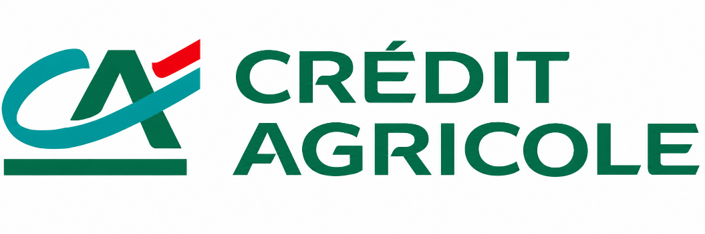
Assessment of Digital Banking
1.1. The Major Forces Impacting Digital Banking Were
Virtual Banks. Virtual banks improved their offerings to differentiate themselves from incumbents.
Mobile Channels. All banks developed mobile channels, though incumbents often struggled.
Banking Platforms. Banks began to use technology to enable third‐party applications.
Notes:
Engagement and Activity Slides
Note:
Include at least one engagement element where appropriate:
Think–Pair–Share
Mini task
Poll or reflection question
Suggested duration: 3–5 minutes
Activities shall align with learning outcomes

Slide 30
Assessment of FinTech (Digital Banking)
1.1. Digital Banking – Where Did Disruption Occur?
Traditional bank distribution models and economics are at risk of being deeply disrupted by the drive towards platform models of banking.
Banks no longer define customer expectations of the banking experience; instead, fintechs and large technology companies set the standard.
Incumbents are starting to migrate core systems to the cloud, as legacy infrastructure creates challenges in meeting customer needs.
Notes:
Engagement and Activity Slides
Note:
Include at least one engagement element where appropriate:
Think–Pair–Share
Mini task
Poll or reflection question
Suggested duration: 3–5 minutes
Activities shall align with learning outcomes

Slide 31
Assessment of FinTech (Digital Banking)
1.1. Traditional banking models deeply disrupted
Traditional bank distribution models and economics are at risk of being deeply disrupted by the drive towards platform models of banking
Catalysed by regulators and driven by a desire to more efficiently satisfy customer needs, platform banking business models – where banks offer connections with other firms in addition to their own – are gaining momentum.
Notes:
Engagement and Activity Slides
Note:
Include at least one engagement element where appropriate:
Think–Pair–Share
Mini task
Poll or reflection question
Suggested duration: 3–5 minutes
Activities shall align with learning outcomes

Slide 32
Traditional banking models deeply disrupted
1.1. Supporting Evidence
Increasing Technology Capacity. APIs, as software intermediaries that allow programmes to connect and interact, provide exposure‐specific functionality while protecting the rest of the application. This API technology, which has achieved broad adoption in recent years, allows banks to seamlessly integrate with third parties and is necessary for developing platform models of banking.
Increasing Regulatory Pressure. Regulators in a number of jurisdictions have begun mandating that banks share data and access with third-party organizations via open APIs. These open banking standards, such as PSD2 in Europe, are expected to weaken banks’ control over customer data and allow customers much greater control over third‐party access to their accounts
Notes:
Engagement and Activity Slides
Note:
Include at least one engagement element where appropriate:
Think–Pair–Share
Mini task
Poll or reflection question
Suggested duration: 3–5 minutes
Activities shall align with learning outcomes

Slide 33
Traditional banking models deeply disrupted
1.1. Supporting Evidence (Continue…)
Shrinking Margins. Margins on banking products are declining due to increased competition, lowering the profitability of product manufacturing. This incentivizes banks to refocus on distribution and seek partnerships with specialized product and service providers – in effect, creating platforms for their customers.
Notes:
Engagement and Activity Slides
Note:
Include at least one engagement element where appropriate:
Think–Pair–Share
Mini task
Poll or reflection question
Suggested duration: 3–5 minutes
Activities shall align with learning outcomes

Slide 34

Traditional banking models deeply disrupted
1.1. Case Studies
Curated platform new entrant
A German digital‐only bank, N26 has clearly identified its user‐centred digital experience as its key differentiator. The bank engages “best‐of‐breed” providers, from Allianz to TransferWise, to offer products that N26 itself does not focus on, thus creating a highly curated platform.
Banks no longer define customer expectations of the banking experience; instead, fintechs and large technology companies set the standard.
Experiences with non‐ incumbents are raising the bar for banks, as customers expect more value‐ driven, personalized and seamless service than ever before. Incumbent banks, focused on recapitalizing their post‐ crisis balance sheets, are playing catch‐ up.
Notes:
Engagement and Activity Slides
Note:
Include at least one engagement element where appropriate:
Think–Pair–Share
Mini task
Poll or reflection question
Suggested duration: 3–5 minutes
Activities shall align with learning outcomes

Slide 35

Traditional banking models deeply disrupted
1.1. Banks no longer define customer expectations on banking
experience…fintechs set standard.
Simple digital P2P payments
Fintech firm Venmo allows users to make P2P payments at no cost, and share their transactions within their social network. It has been so successful (transferring over $5 billion in the last three months of 2016) that major US banks have launched Zelle, a competitor offering free payment transfers and links directly with bank accounts, in the hope of taking back market share
Notes:
Engagement and Activity Slides
Note:
Include at least one engagement element where appropriate:
Think–Pair–Share
Mini task
Poll or reflection question
Suggested duration: 3–5 minutes
Activities shall align with learning outcomes

Slide 36

Traditional banking models deeply disrupted
1.1. Incumbents moving systems to cloud
Incumbents are starting to migrate core systems to the cloud, as legacy infrastructure creates challenges in meeting customer needs.
Banks have undertaken significant efforts to move to a newer, cloud‐based architecture, but still struggle with legacy infrastructure that weighs down profits and limits banks’ ability to meet customer needs
Notes:
Engagement and Activity Slides
Note:
Include at least one engagement element where appropriate:
Think–Pair–Share
Mini task
Poll or reflection question
Suggested duration: 3–5 minutes
Activities shall align with learning outcomes

Slide 37
Few customers moved from deposit accounts…for now
Value of Physical Presence. Customers’ preferences are quickly shifting to digital channels, but physical branches remain a critical component of the banking experience. Many customers have banking needs which only physical locations can currently fulfill (e.g. getting a same‐day wire transfer for a home purchase), while other customers prefer a channel based on human interaction.
Poor Challenger Bank Economics. Because challenger banks are unable to meet more complex needs, they tend to be used as secondary bank accounts by most customers, causing them to lose out on a large share of revenue. Also, to attract customers, they often provide either lower fees or higher returns on deposits than incumbents, both of which lower profitability.
Notes:
Summary and Closure Slides
Note:
Summarise 3–5 key takeaways
Reinforce main ideas
Indicate CLO coverage where appropriate
Include:
Upcoming topics
Required reading
Tutorial / lab / assessment linkage

Slide 38
Strategies by Incumbent Banks
Value of Incumbents Targeting Attractive Customers. The profitability of many customer segments declined following the financial crisis, as wealth levels fell and interest rates approached zero. In response, incumbents refocused their efforts on optimizing their client base – retaining their most profitable customer segments, and ensuring that only less profitable customers would be tempted to switch to challenger banks.
Ability to Fast Follow. Very few technological barriers to entry affect the development of an online or mobile challenger bank (the majority of the barriers concern regulation). Thus, if customer defections to challenger banks accelerate, incumbents can quickly follow with visually appealing front‐end offerings or an online bank of their own
Notes:
Summary and Closure Slides
Note:
Summarise 3–5 key takeaways
Reinforce main ideas
Indicate CLO coverage where appropriate
Include:
Upcoming topics
Required reading
Tutorial / lab / assessment linkage

Slide 39
SUMMARY
By the end of this session:
Essential Innovation: Mobile banking is a key driver of financial innovation, effectively turning mobile phones into pocket-sized bank branches.
Usability is Critical: Successful mobile banking requires an intuitive interface, rich features, high security, and personalized experiences.
Mutual Benefits: It offers extreme convenience for customers while giving banks lower operational costs, higher customer retention, and increased profitability.
Major Challenges: The biggest hurdles for financial institutions are maintaining robust security and integrating mobile apps with their older, legacy systems.
Industry Disruption: FinTechs and mobile-only banks are setting the new standard for customer expectations, forcing traditional banks to adopt cloud technology and platform models to compete.
Notes:
Summary and Closure Slides
Note:
Summarise 3–5 key takeaways
Reinforce main ideas
Indicate CLO coverage where appropriate
Include:
Upcoming topics
Required reading
Tutorial / lab / assessment linkage

Slide 40

THANK YOU
Shuhaida Bt M Shuhidan
DEPARTMENT OF COMPUTING
shuhaida.shuhidan@utp.edu.my
01-03-31

